Slide 1
Today we will be covering:
Why we use ESSENTIALS.
Some of the key approaches that we use in KS1.
A chance for you to see how different equipment is used.

Slide 2
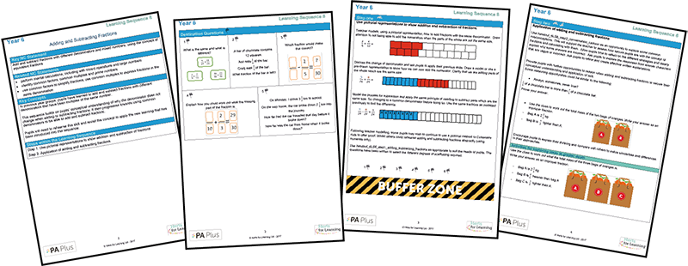
Why are we using
Herts ESSENTIALS?

Slide 3
Aims of the National Curriculum
The national curriculum for mathematics aims to ensure that all pupils:
become fluent in the fundamentals of mathematics, including through varied and frequent practice with increasingly complex problems over time, so that pupils develop conceptual understanding and the ability to recall and apply knowledge rapidly and accurately
reason mathematically by following a line of enquiry, conjecturing relationships and generalisations, and developing an argument, justification or proof using mathematical language
can solve problems by applying their mathematics to a variety of routine and non-routine problems with increasing sophistication, including breaking down problems into a series of simpler steps and persevering in seeking solutions.

Slide 4
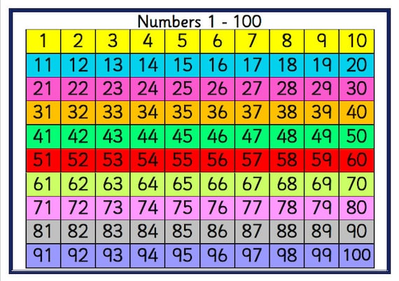
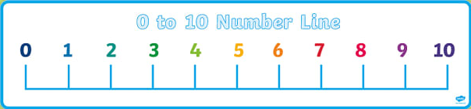
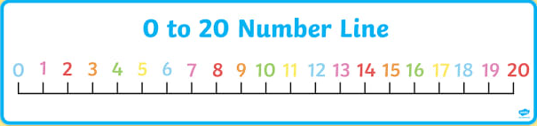
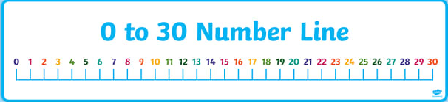
Hundred Square and Number Line
Counting on
Counting back
Counting by 2, 5, 10

Slide 5
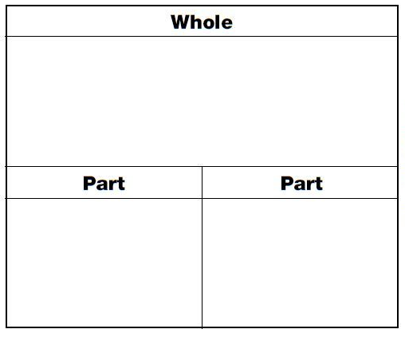
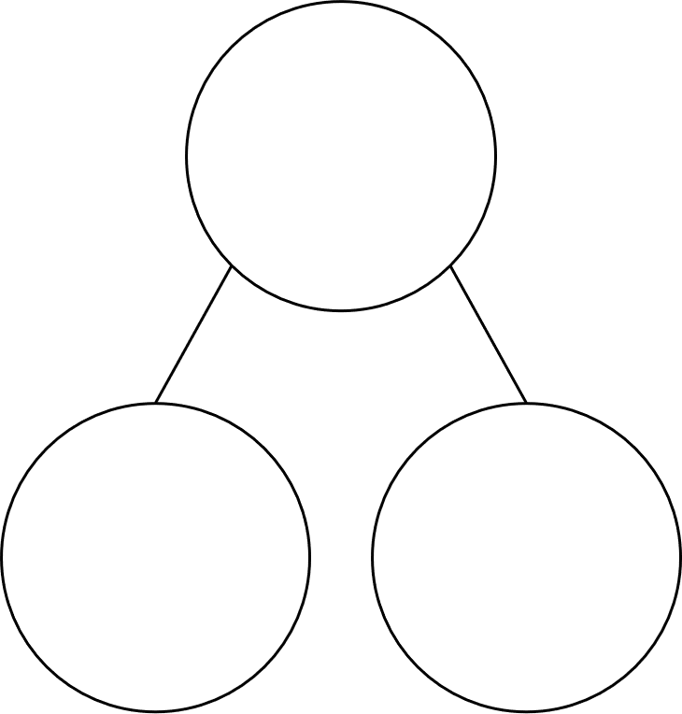
Bar Model and Cherry Model
As part of the pictorial method, we draw ‘bars’ or fill in a cherry model to show different parts of out calculations, especially when demonstrating the parts and a whole.

Slide 6
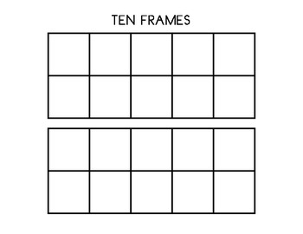
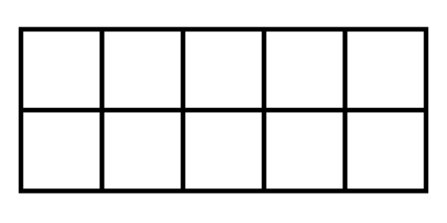
Ten or Twenty Frame
As part of the pictorial method, we use a ten or twenty frame to represent number to assist in the use of addition, subtraction and quick fire counting.

Slide 7
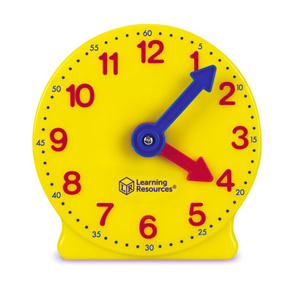
Counting Clocks
For time, we use clocks that colour code the hour and minute hand to show the difference. We have the numbers showing that there are 5 minutes between each large number to assist in the counting in 5s to find the time when we are moving beyond o’clock, quarter past, half past and quarter to.

Slide 8
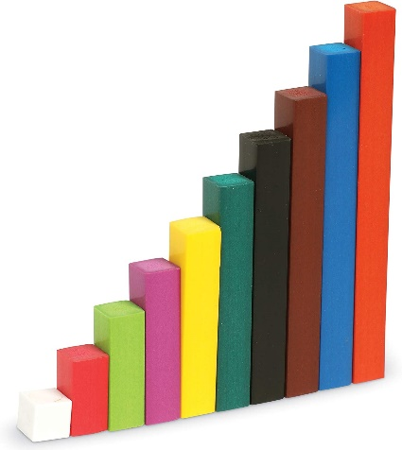
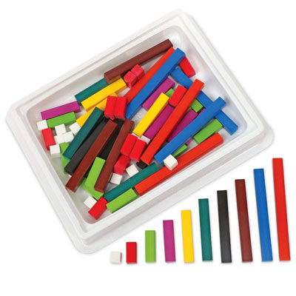
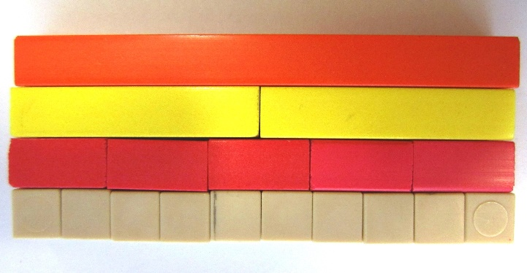
Cuisenaire Rods
Fractions
Comparison
Number Bonds
Algebra

Slide 9
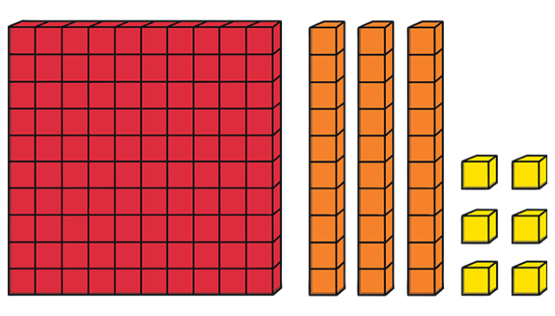
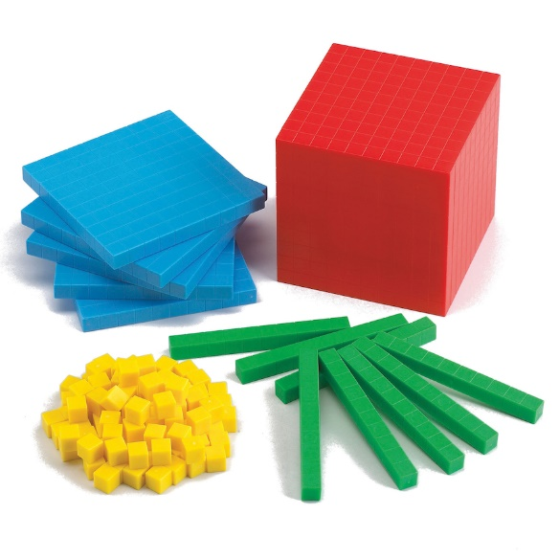
Base 10
Subtraction
Addition
Division
Multiplication
Place Value

Slide 10
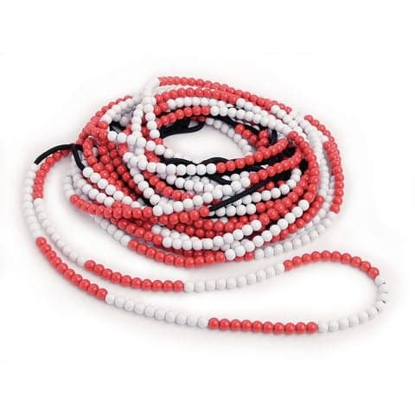
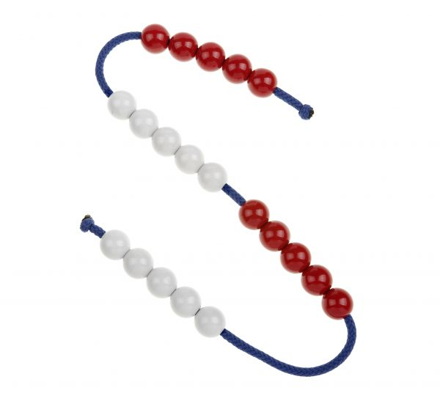
Bead Strings
Subtraction
Addition
Multiplication
Division
Place Value

Slide 11
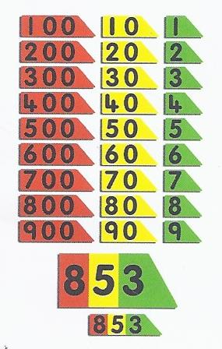
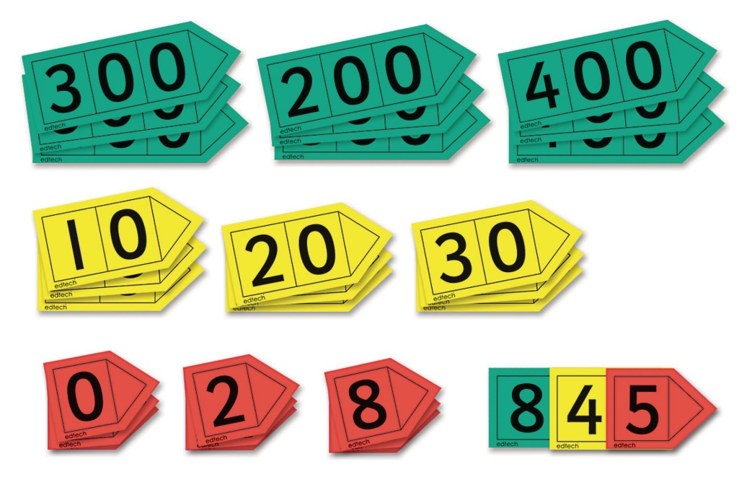
Place Value Cards
Place value cards are used when exploring the splitting of a number into ones, tens and hundreds.

Slide 12
Doing Maths at Home!
A prominent clock – Digital if necessary but analogue is even better! Place it somewhere where you can talk about the time each day.
A traditional wall calendar – Calendars help with counting days, spotting number patterns and exploring the passing of time.
Board games that involve dice or spinners – Helps with counting and the ideas of chance.
A pack of playing cards – Card games can be adapted in many waus to learn about number bonds, chance, adding and subtracting.
Fridge magnets with numbers on – Can be used for a little practise of written method, adding, subtraction, missing numbers on a number line or place value of tens and ones.
Unusual dice – Dice that do not have traditional 1-6 numbers, hexagonal dice, coloured dice or dice from a board game allow children to be seeing numbers in different ways.
Hundred Square and/or Numberline – Printed for free online or off this PowerPoint to assist in Maths addition, subtraction, counting in multiples and for children to assist you when completing mental maths.
Ten Frame and Cherry Model – Printed for free online or off this PowerPoint to assist in Maths homework for addition and subtraction.

